Slide 1
Internet of things

Slide 2
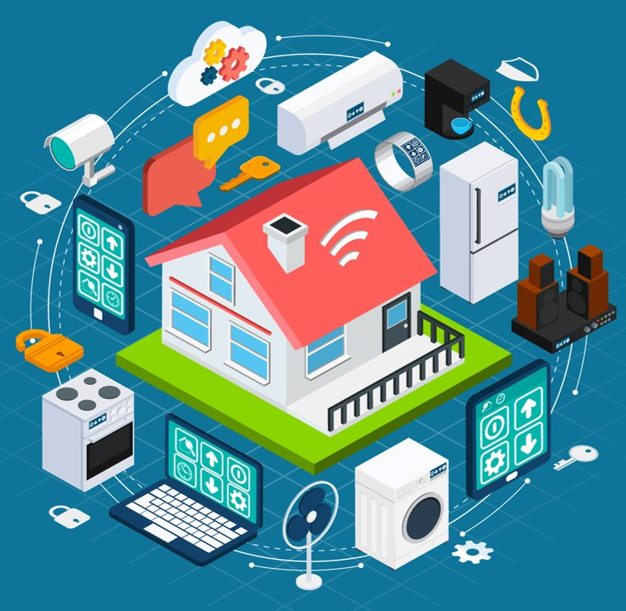
the networking capability that allows information to be sent to and received from objects and devices (such as fixtures and kitchen appliances) using the Internet

Slide 3
Hardware
Software
Connectivity
Data

Slide 4



Slide 5
The End

